Slide 1
US Parks Visitors Data Trend
Data Science Department, I590 - SQL/NoSQL Project
Huzefa Igatpuriwala
Saurabh Swaroop
Vijayakumar Perumalsamy
INDIANA UNIVERSITY BLOOMINGTON

Slide 2
Problem Statement & Motivation
SECTION 1

Slide 3
Problem Statement
Parks are iconic symbols of United States which represent beauty of nature, historic site, monument or wildlife reserve .
379 Parks in US are operated/managed by National Parks Services(NPS)
Key factors which determine choosing a Park are as below
Temperature/Weather Conditions during time of visit.
Approx. visitor count during time of visit.

Slide 4
Motivation
Cost and Effort for Park visit make it very important to choose an ideal park.
For a particular month, factors like crowd and weather need to be analysed before visit.
Increase in visitor count is also influenced by ease of availability of cameras and smartphones nowadays.
As a visitor, moderates crowds and ideal weather make it a worthwhile trip.
For food vendors, ideal park selection becomes important for sales.
Good data analysis or visualizations are hard to find for National Parks.

Slide 5
Data, Objective and Technologies Used
SECTION 2

Slide 6
Data
Integrated Resource Management Applications(IRMA) provides easy access to National Park Service Information.
Portal provides month-wise visitor count for all National Parks from 1904 to 2019.
The data was downloaded in CSV format for past 10yrs from IRMA
Additionally, Google Maps API was used to tie Geolocation info with National Parks.

Slide 7
Objective
Identify how parks visitor data can be leveraged to make someone’s trip worthwhile.
Data Preprocessing
Using NoSQL Database for Analysis/Visualizations.
Using SQL Database with Interactive Web Client.

Slide 8
Technologies Used and Why?
Jupyter Notebooks with Pandas Library.
Powerful way to write and iterate Python code
Pandas is capable of data analysis with minimal coding.
MongoDB, PyMongo and IPyWidgets.
NoSQL collection DB with the power similar to SQL database.
PyMongo is python distribution for working with MongoDB.
Jupyter Widgets ‘interact’ for UI controls
MySQL and Amazon Web Services.
MySQL popular open source DB for Web application development.
AWS provides on demand access to scalable web and app servers, storage DB’s, content delivery and other apps for easy build of web apps.

Slide 9
Research Questions & Results
SECTION 3

Slide 10
Research Questions
Count of Different Park Types across US.
Countrywide Spread of Parks as per park type.
Different kinds of visitors across parks in past 10yrs.
Monthly Average of visitors in past 10yrs for each park.
Count of visitors for each month and year per park.
Statewise Park Type count.
Yearly Count of Each Recreation Type(Visitors) per park.
Interactive Web Application for Real Time Querying.

Slide 11
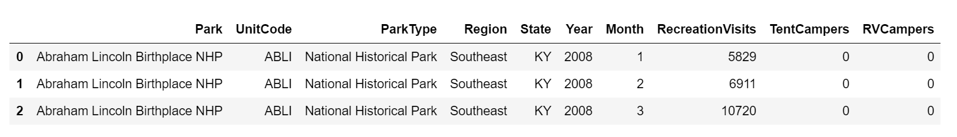
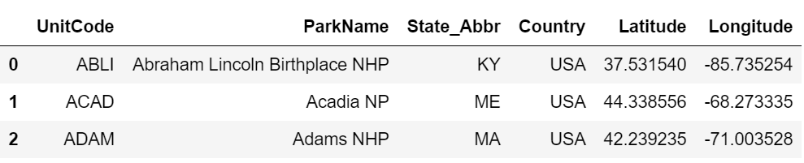
Results
Data Preprocessing
Data pulled from IRMA
Geo Location from Google API for Parks

Slide 12
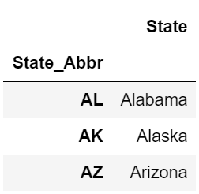
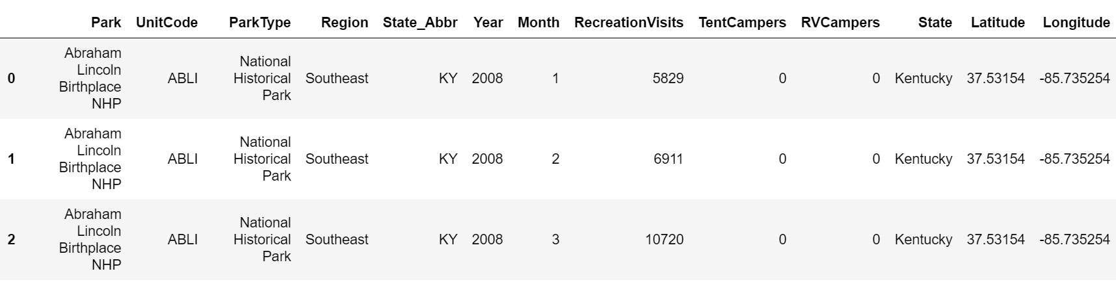
Data Preprocessing(Cont.)
States and Abbreviations
Final Merged Dataset (Data from IRMA + Google API + State Abbreviations)

Slide 13
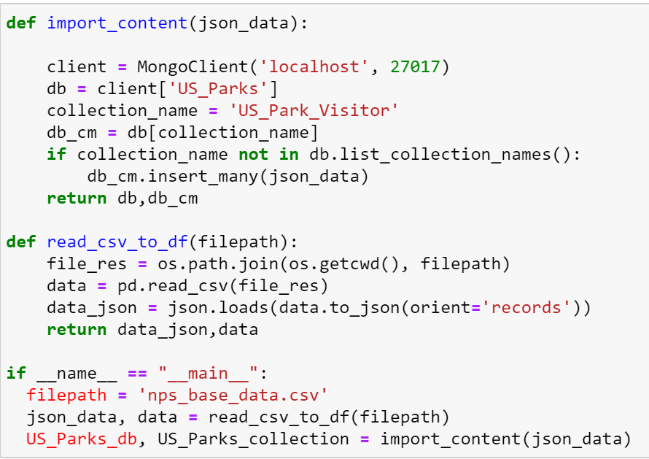
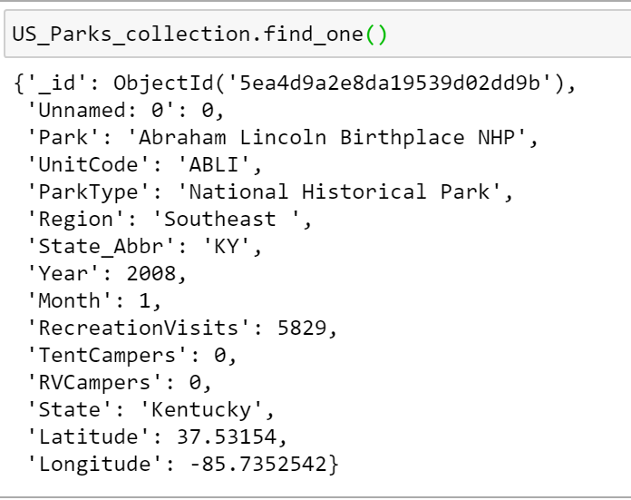
Data Preprocessing(Cont.)
Import to MongoDB and Sample Document

Slide 14
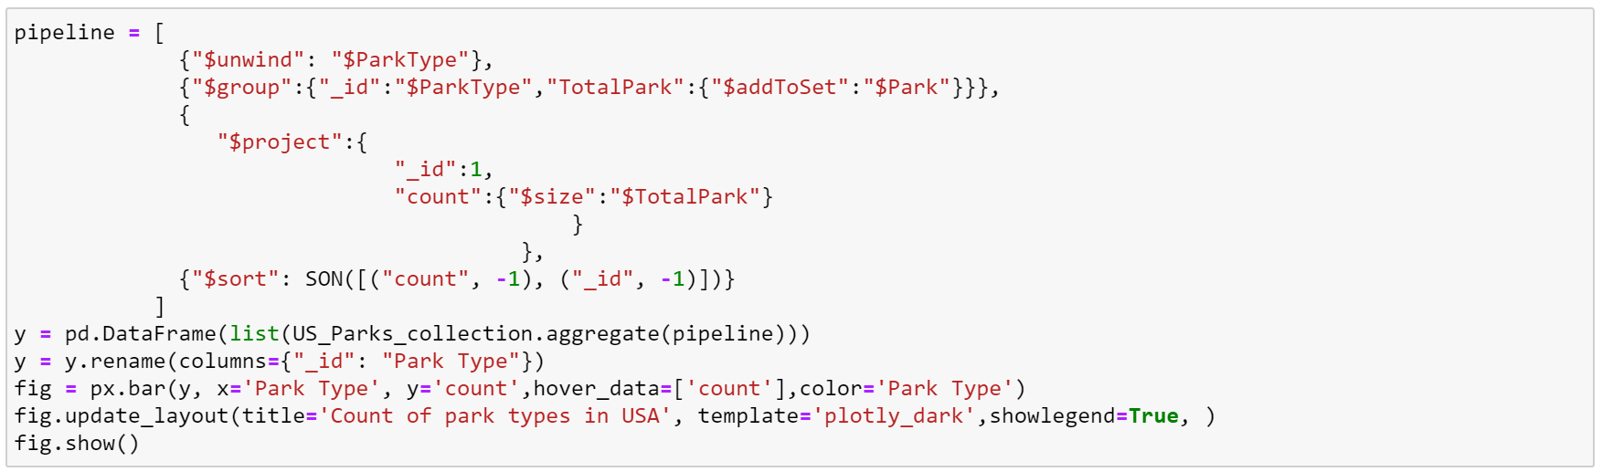
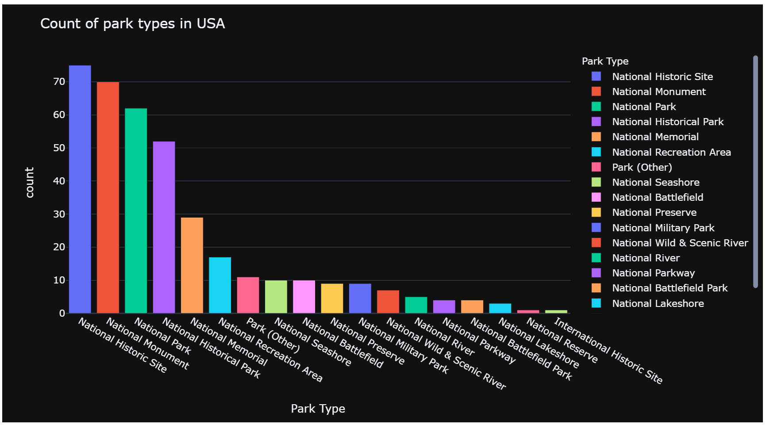
MongoDB Aggregations using PyMongo
Count of Different Park Types across US.

Slide 15

MongoDB Aggregations using PyMongo(Cont.)
Countrywise Spread of Parks using Geo-Location Info

Slide 16
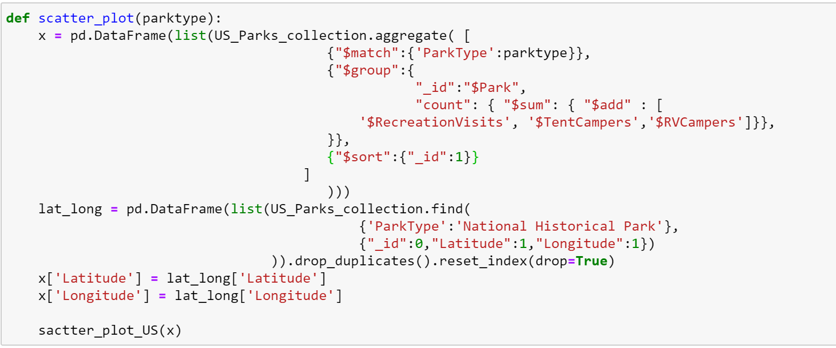
MongoDB Aggregations using PyMongo(Cont.)
Countrywise Spread of Parks using Geo-Location Info.

Slide 17
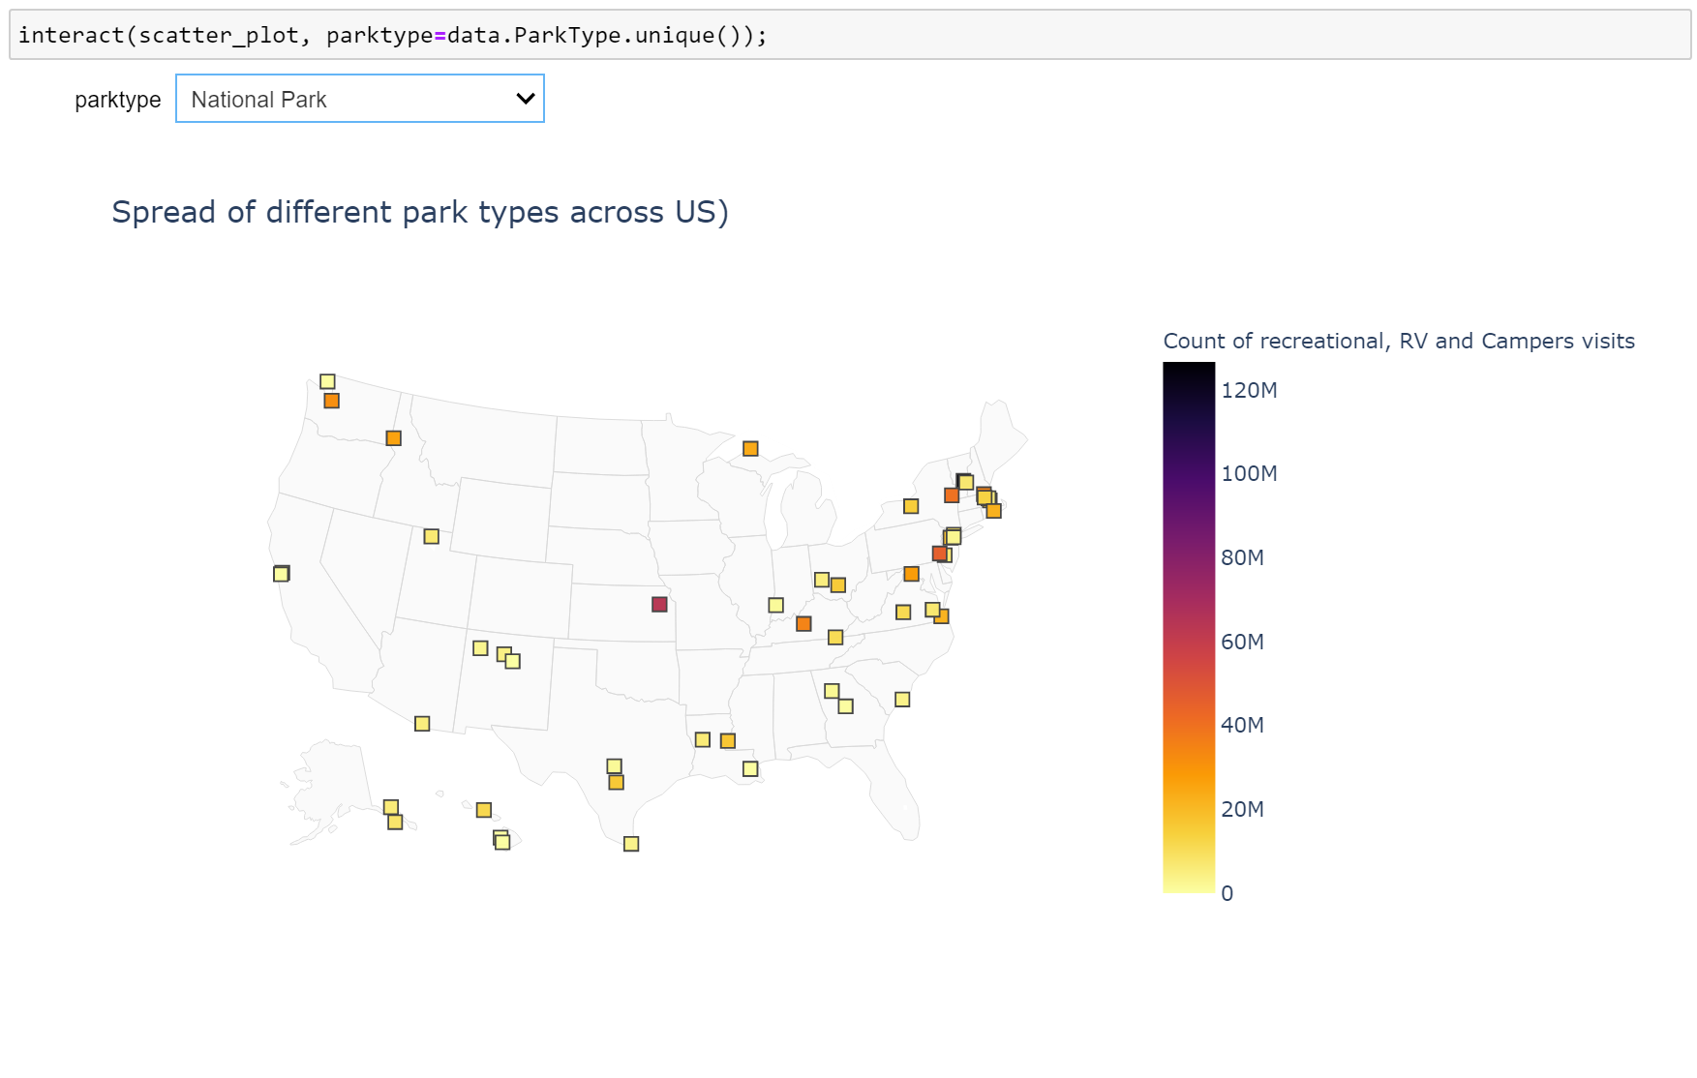
MongoDB Aggregations using PyMongo(Cont.)
Countrywise Spread of Parks using Geo-Location Info

Slide 18
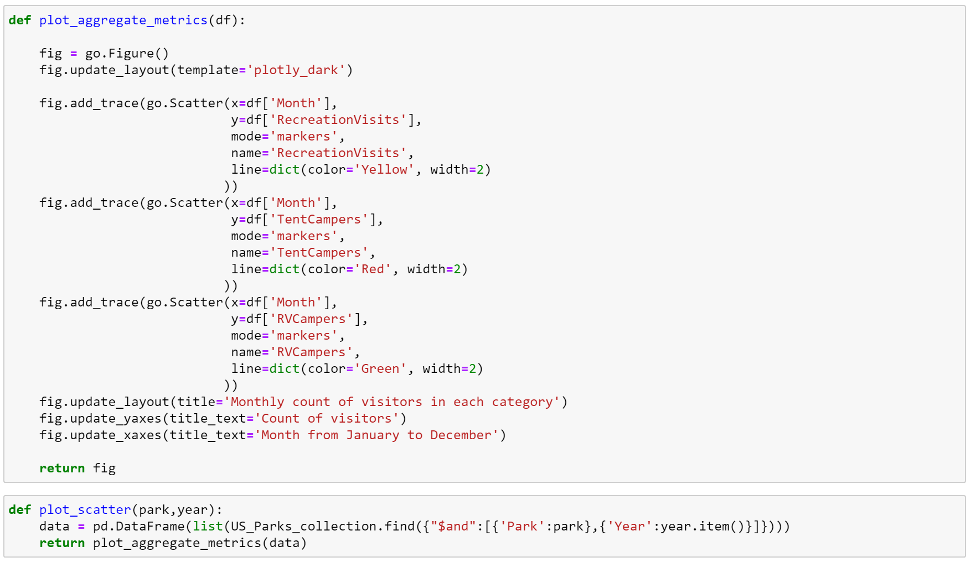
MongoDB Aggregations using PyMongo(Cont.)
Different kinds of visitors across parks in past 10yrs.

Slide 19
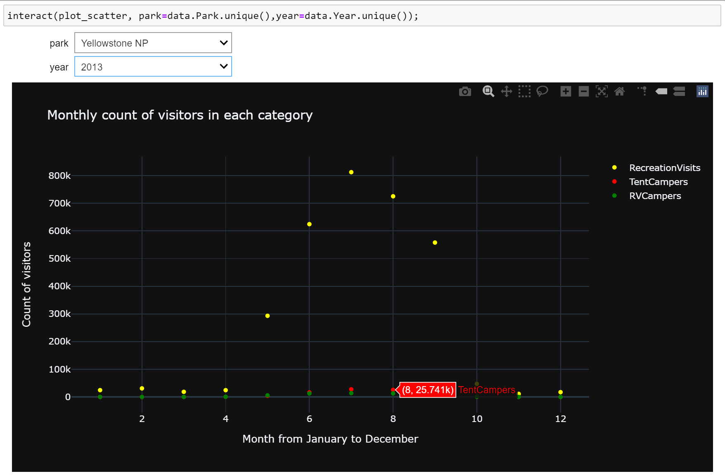
MongoDB Aggregations using PyMongo(Cont.)
Different kinds of visitors across parks in past 10yrs.

Slide 20
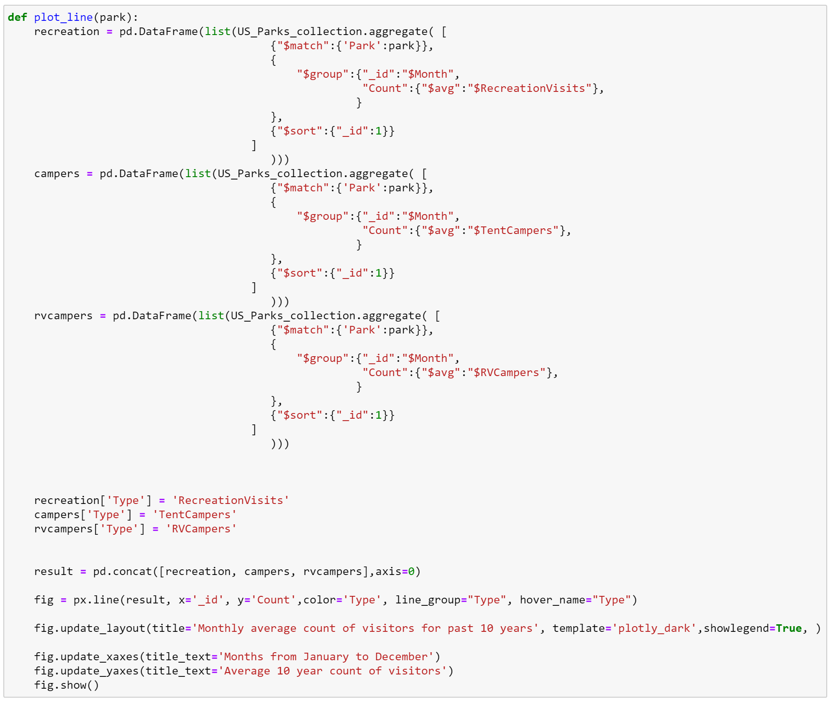
MongoDB Aggregations using PyMongo(Cont.)
Monthly Average of visitors in past 10yrs for each park.

Slide 21
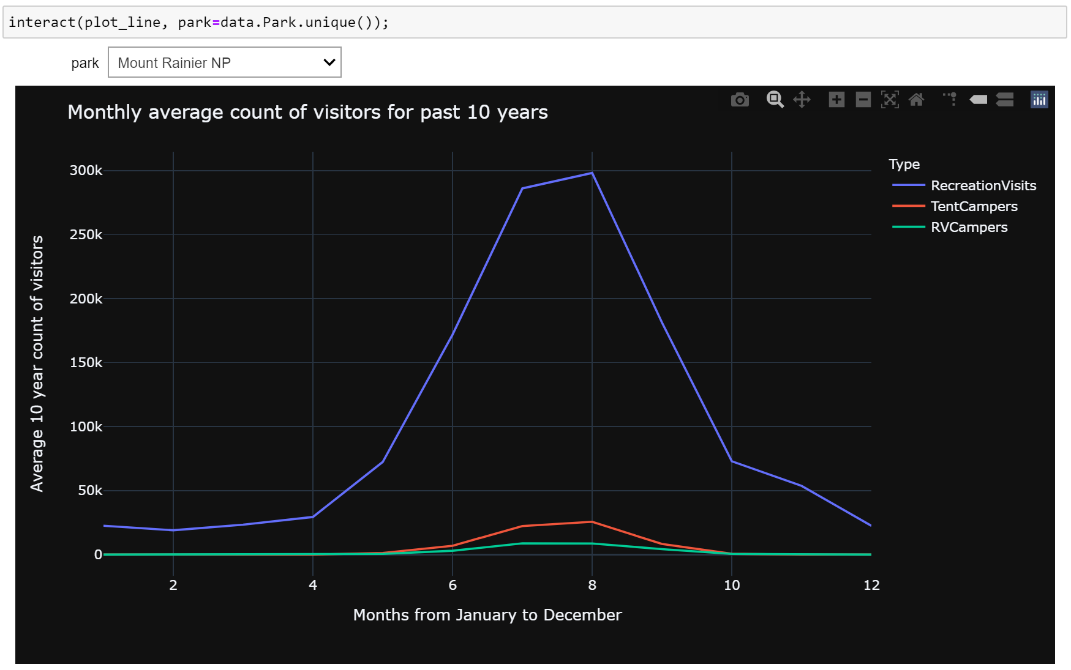
MongoDB Aggregations using PyMongo(Cont.)
Monthly Average of visitors in past 10yrs for each park.

Slide 22
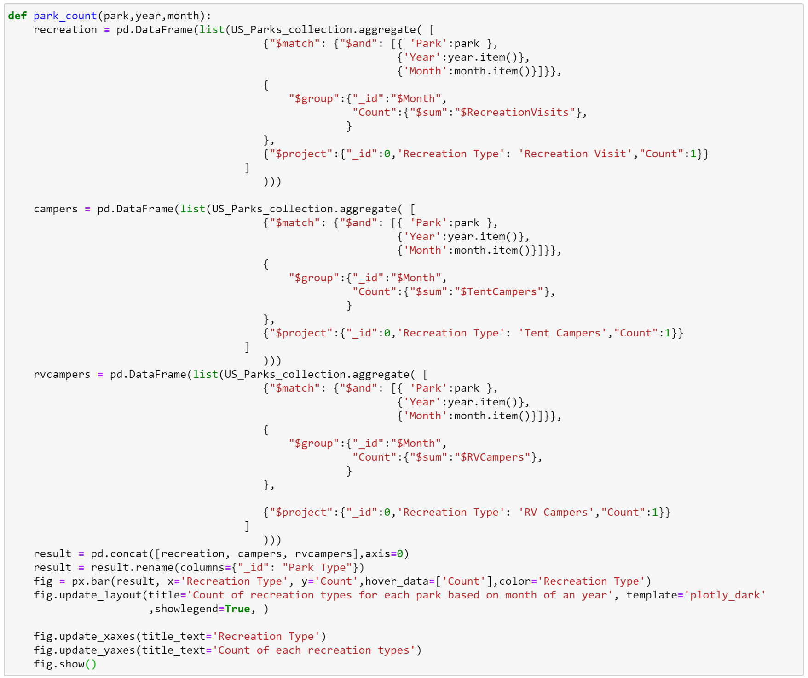
MongoDB Aggregations using PyMongo(Cont.)
Count of visitors for each month and year per park.

Slide 23
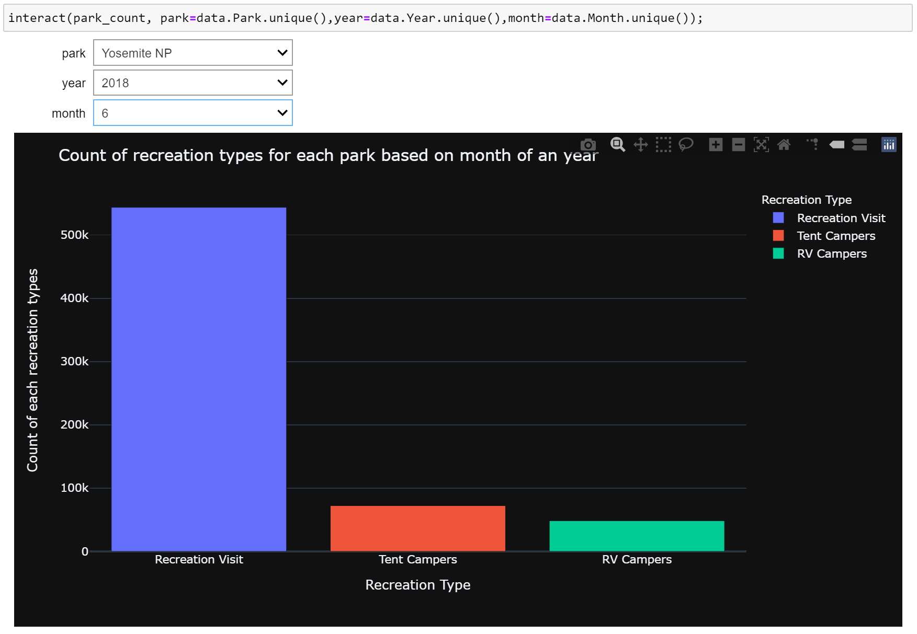
MongoDB Aggregations using PyMongo(Cont.)
Count of visitors for each month and year per park.

Slide 24
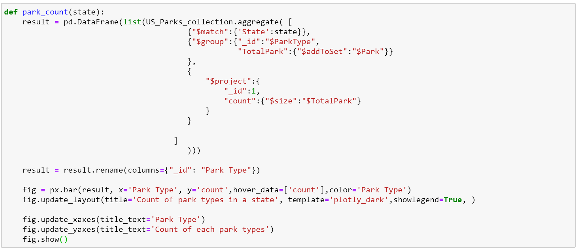
MongoDB Aggregations using PyMongo(Cont.)
Statewise Park Type count.

Slide 25
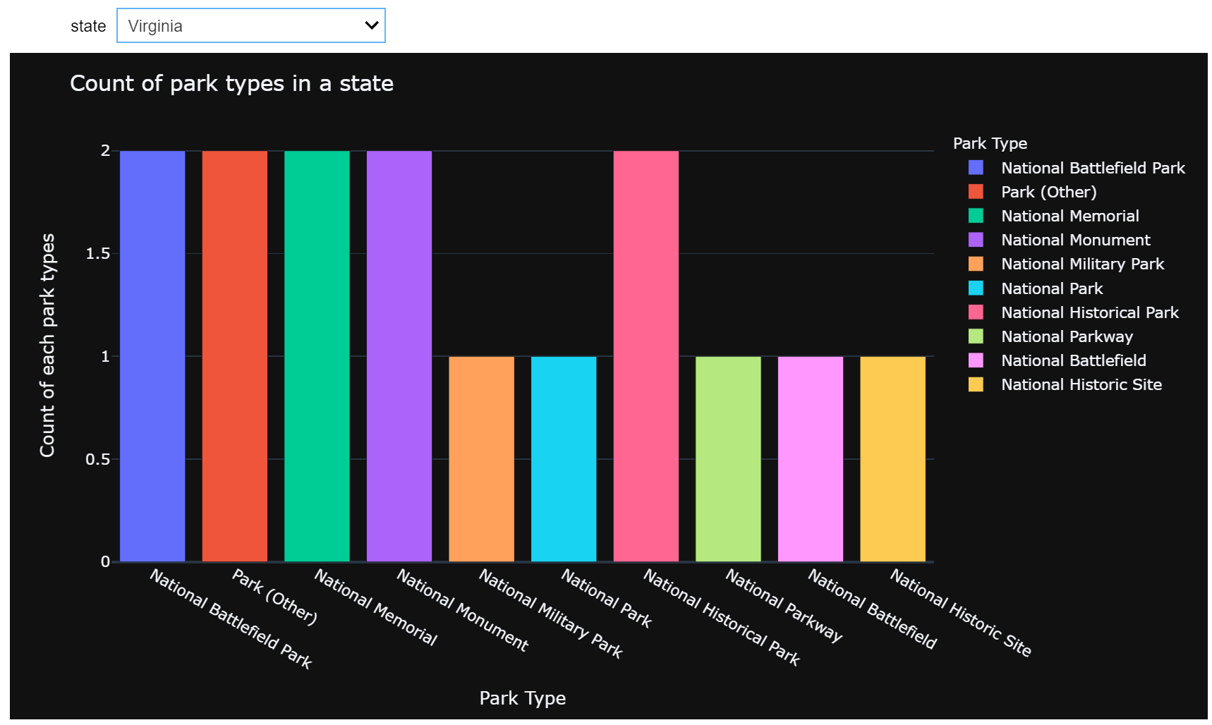
MongoDB Aggregations using PyMongo(Cont.)
Statewise Park Type count.

Slide 26
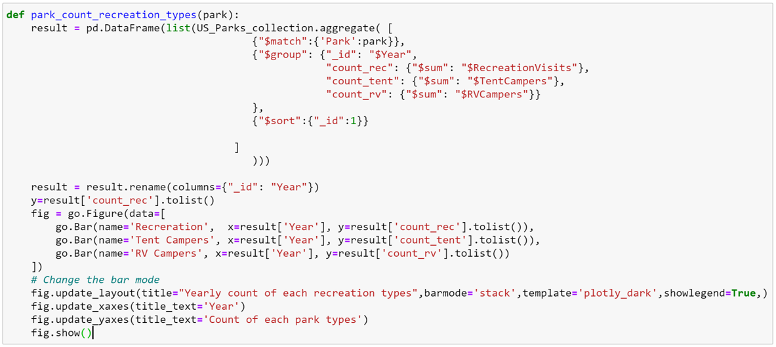
MongoDB Aggregations using PyMongo(Cont.)
Yearly Count of Each Recreation Type(Visitors) per park.

Slide 27
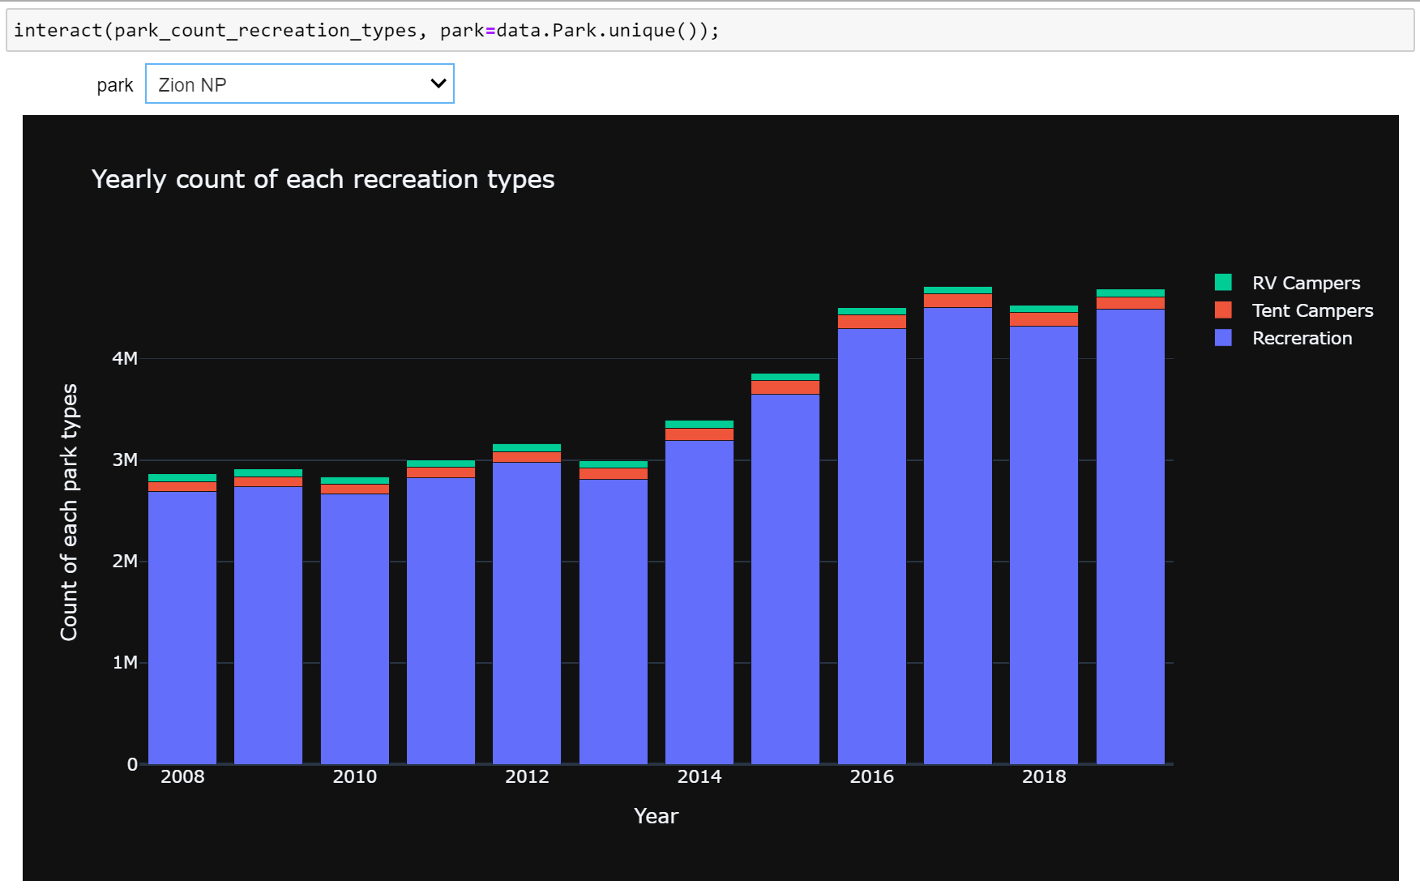
MongoDB Aggregations using PyMongo(Cont.)
Yearly Count of Each Recreation Type(Visitors) per park.

Slide 28
Interactive Web Application
Design
Normalize Final Merged CSV into 2 tables in MySQL DB.
Park Locations – Contains Park Details with State and Lat/Long co-ordinates.
Park Visitors – Contains Month-wise park visitor count for past 10yrs.
Build Python Web-application and Test in Local.
Migrate Local MySQL data to AWS RDS MySQL.
Deploy Local Python Web-App to AWS EC2 Instance.
Use Interactive Web-App for Real-Time Querying/Reporting.

Slide 29
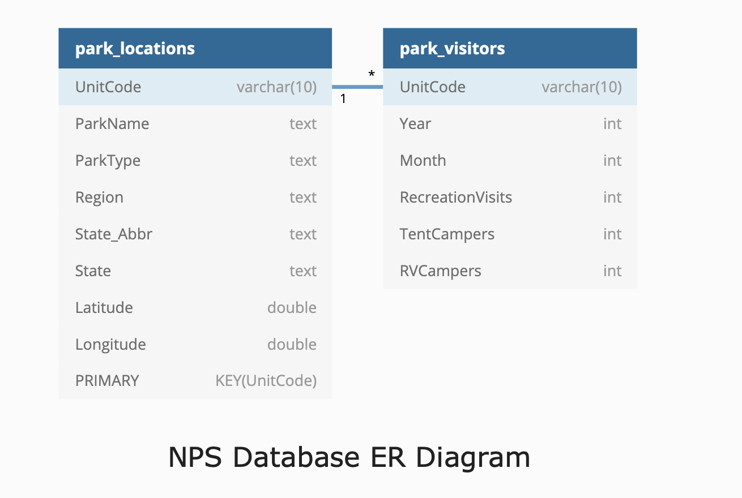
Design
ER Diagram of NPS Parks Visitors database.

Slide 30
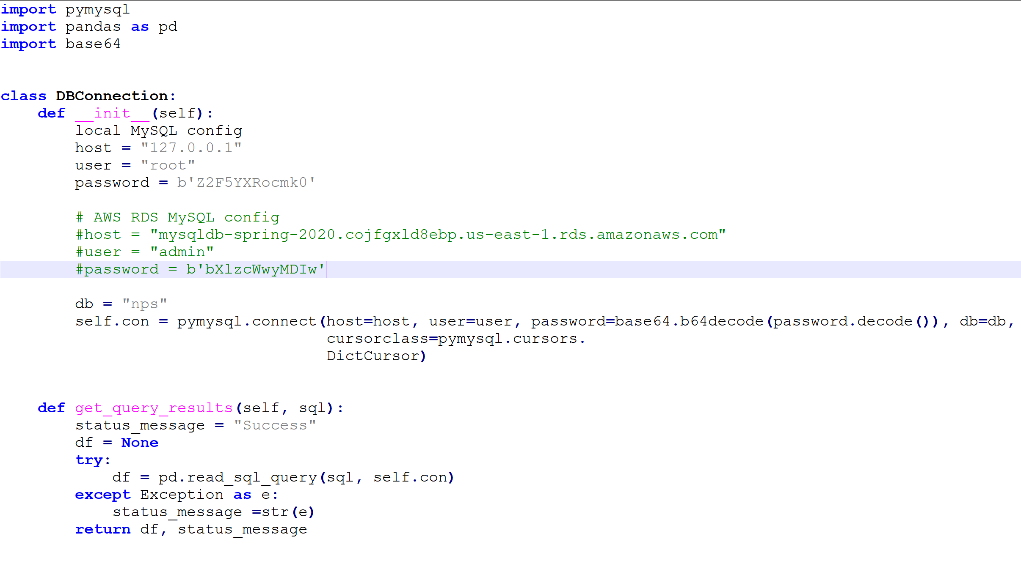
Design
Python Web-application for Testing Locally.

Slide 31
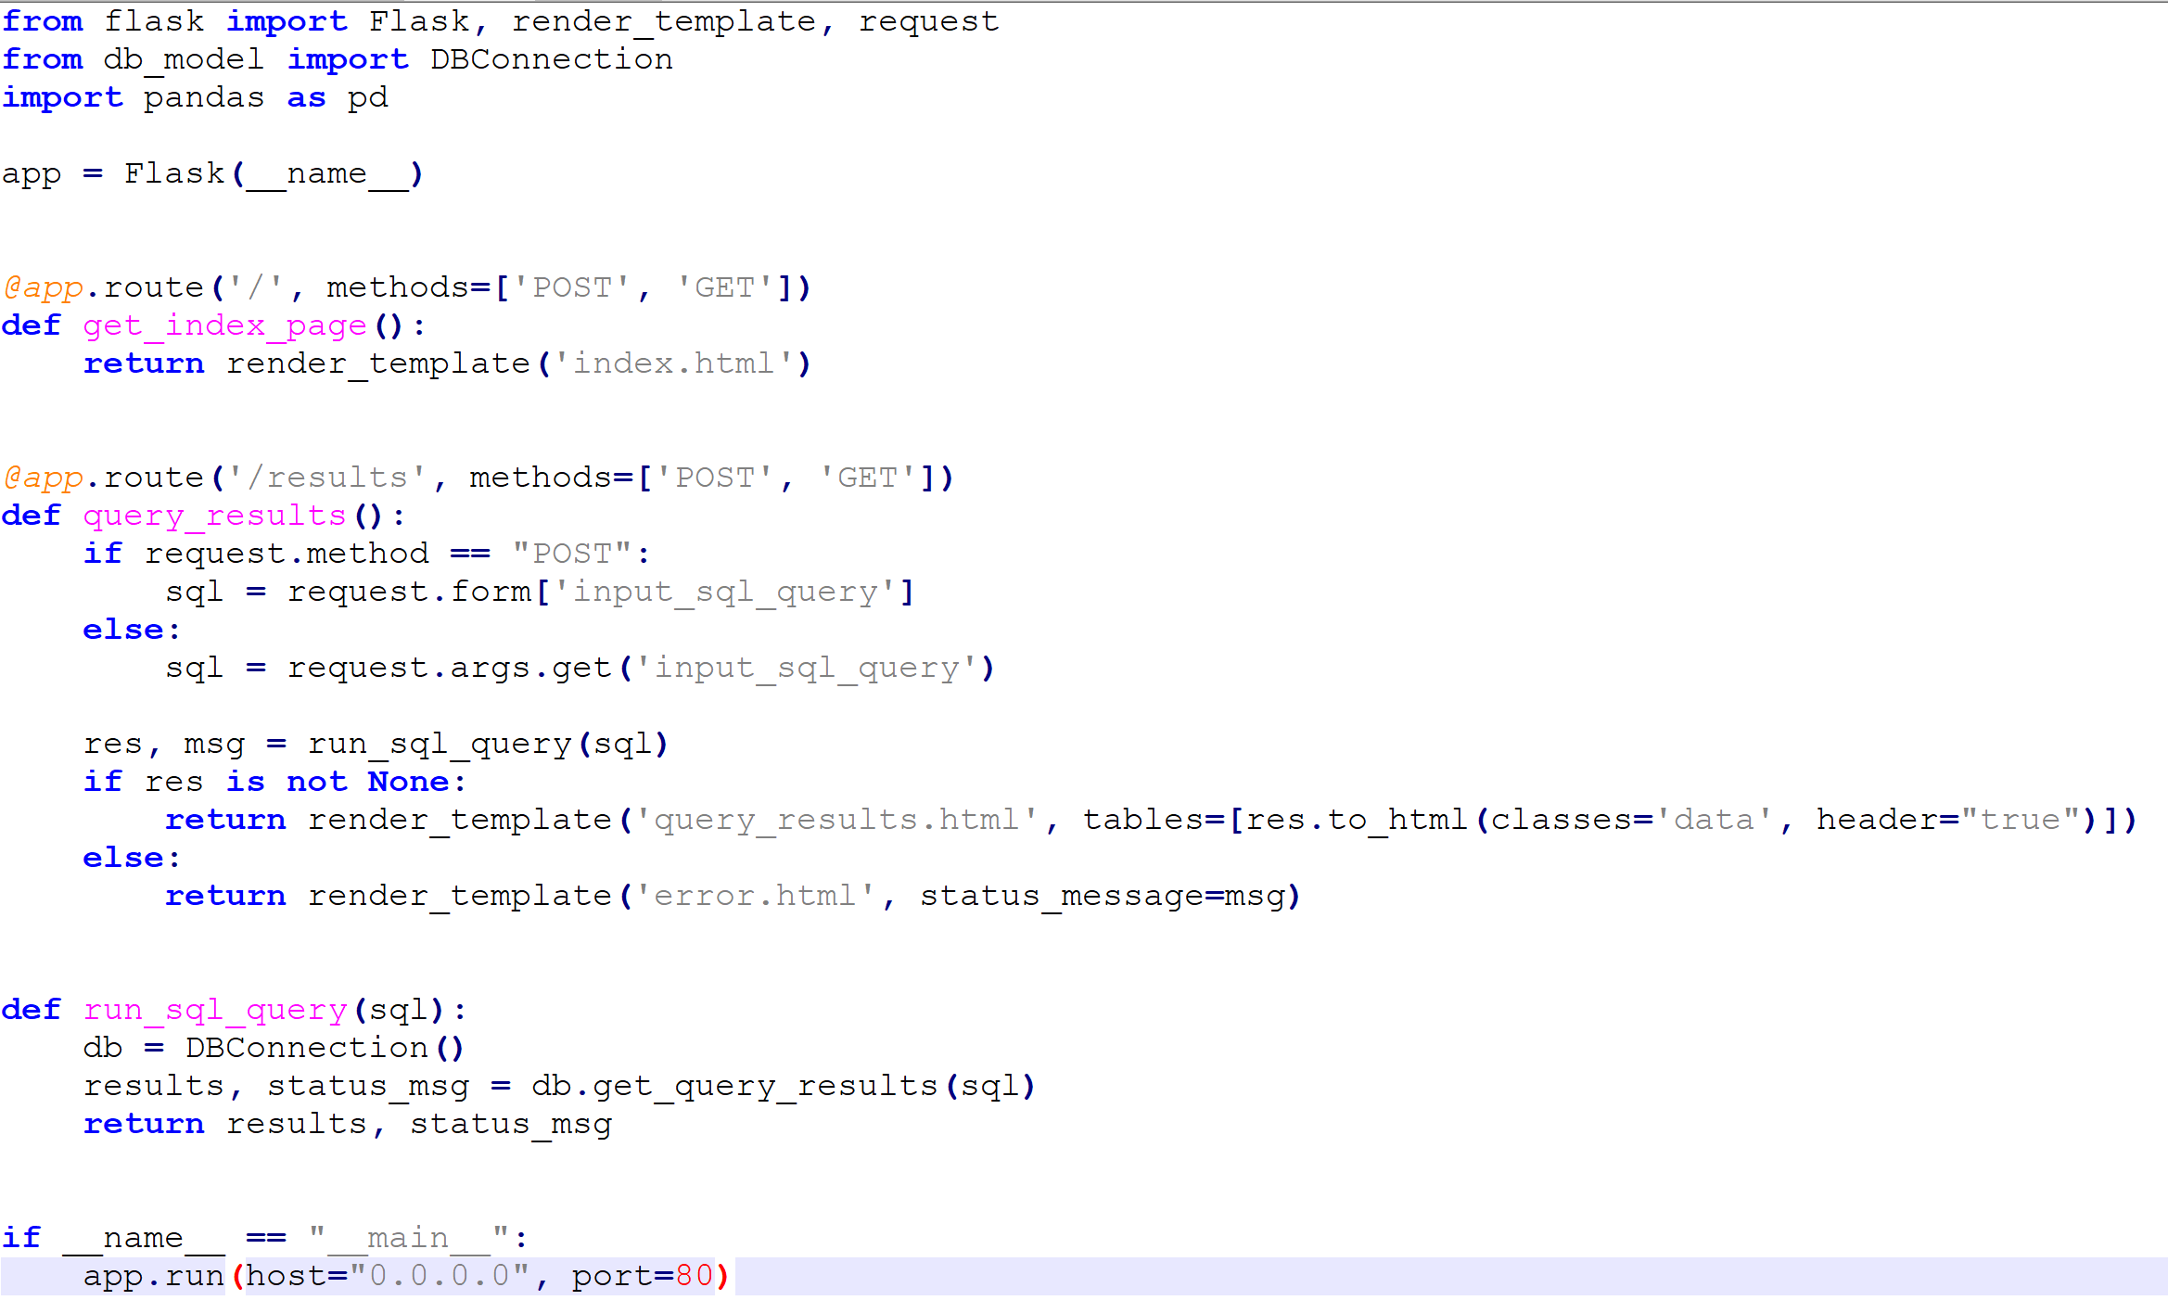
Design
Python Web-application for Testing Locally.

Slide 32
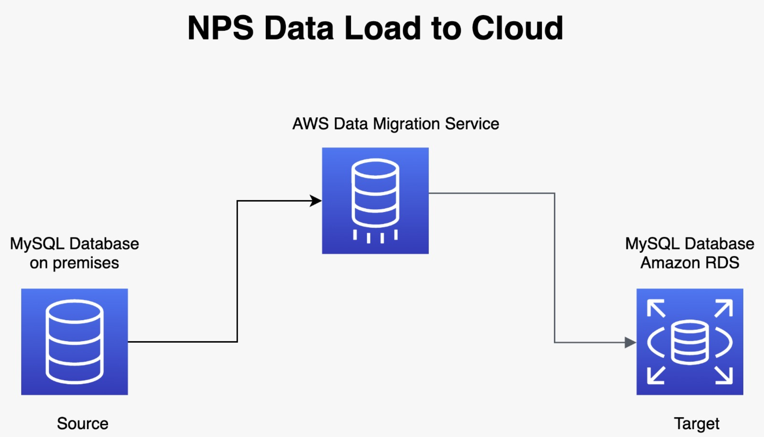
Design
Migrate Local MySQL data to AWS RDS MySQL (Using AWS Data Migration Service).

Slide 33
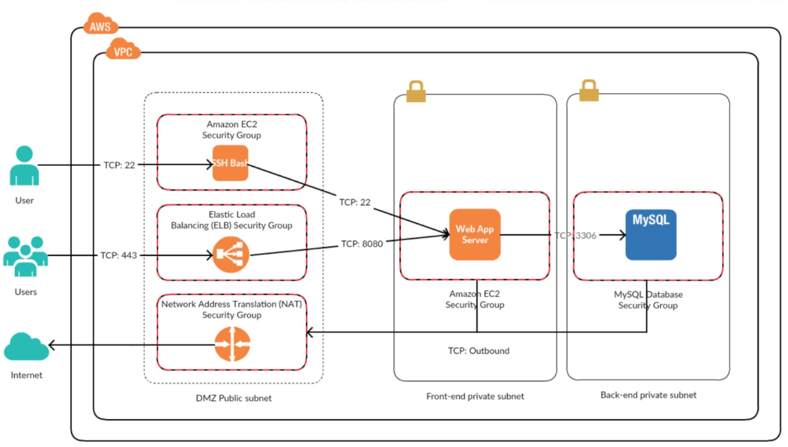
Design
Deploy Local Python Web-App to AWS EC2 Instance.

Slide 34
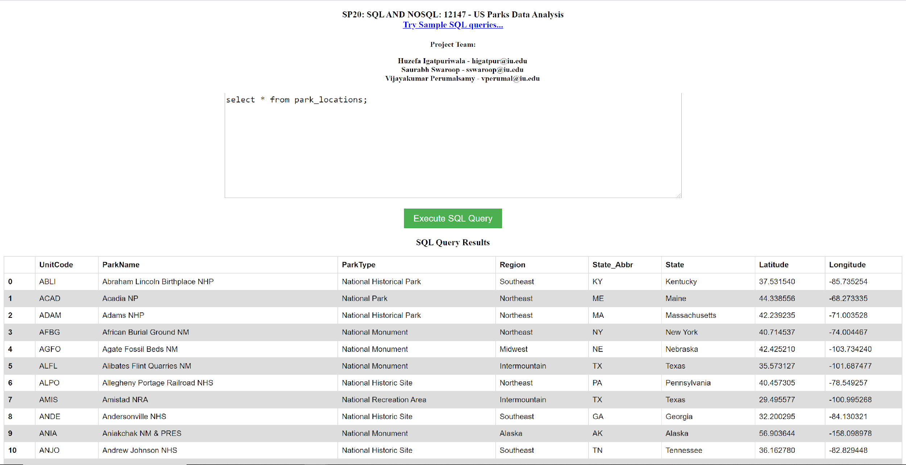
Design
Use Interactive Web-App for Real-Time Querying/Reporting.

Slide 35
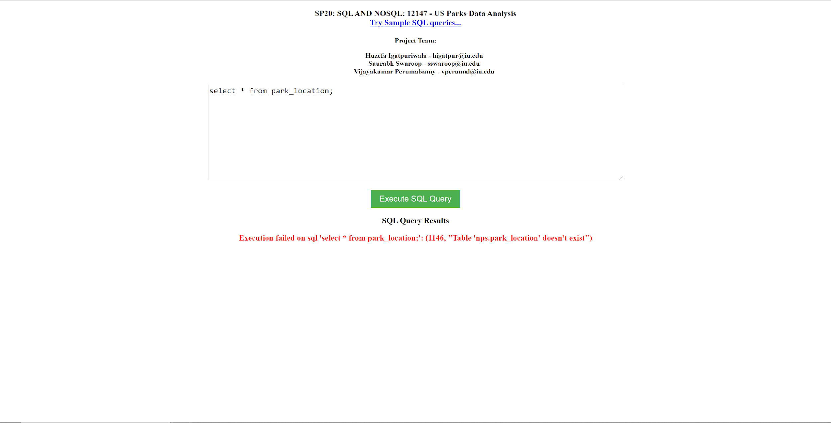
Design
Error Message Integration on Web-App

Slide 36
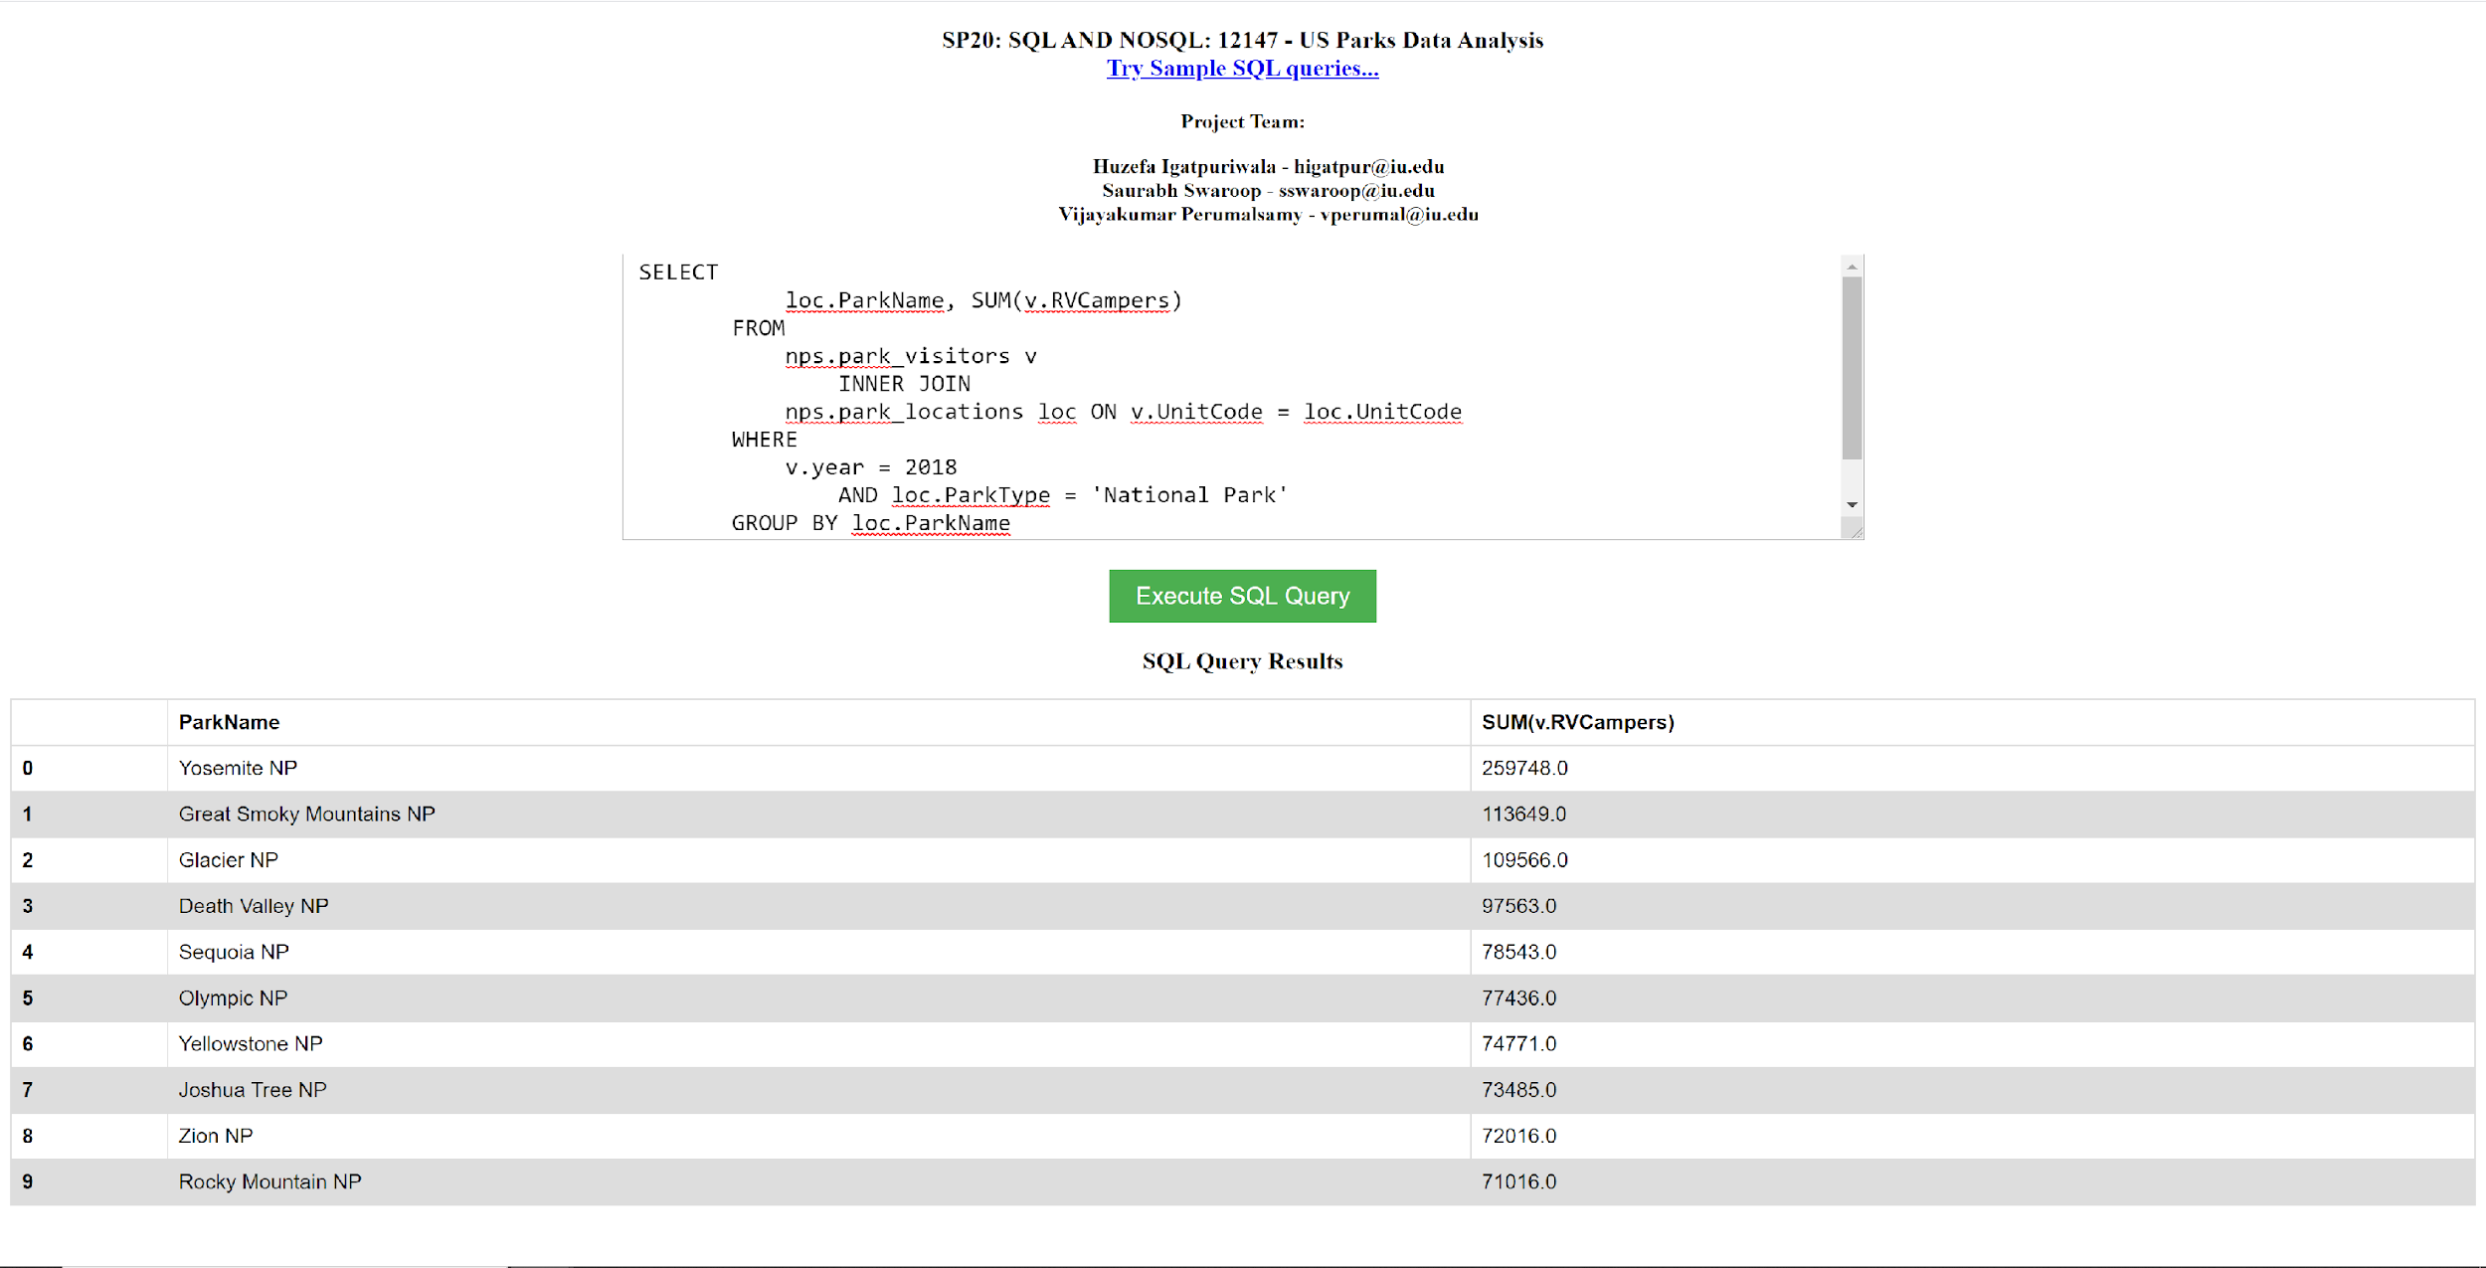
Design
Top 10 Most Visited National Parks in US

Slide 37
Thank You!

